Slide 1
Tiket Pesawat
Muhammad Irfan Fakhrianto – 1806200356
Aurellio Fishandy - 1806199966

Slide 2
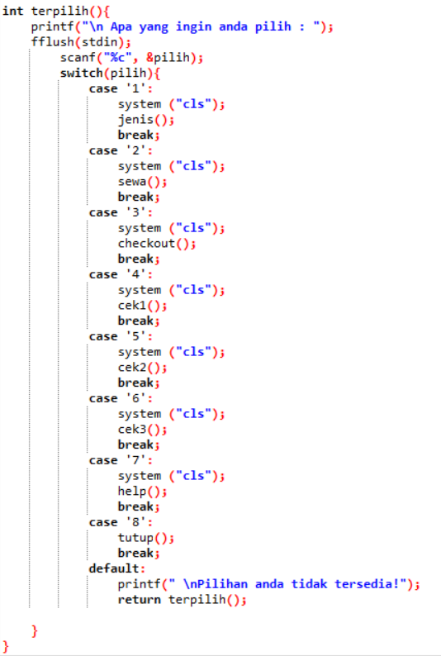
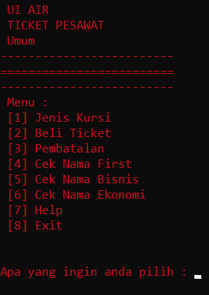

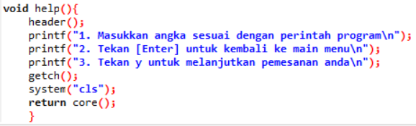
Tampilan Utama
Cara Kerja

Slide 3
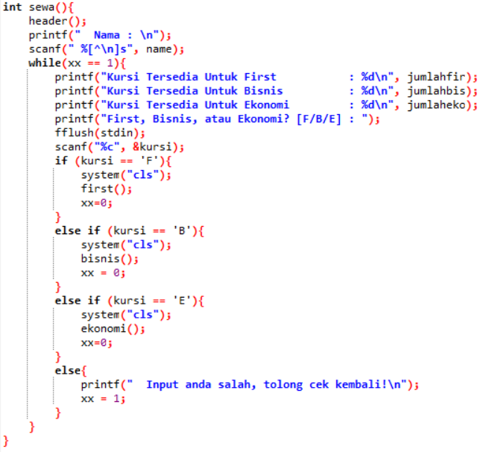
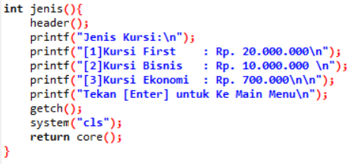
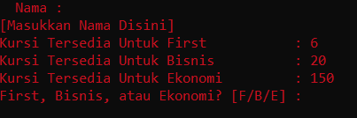
Beli Ticket

Slide 4
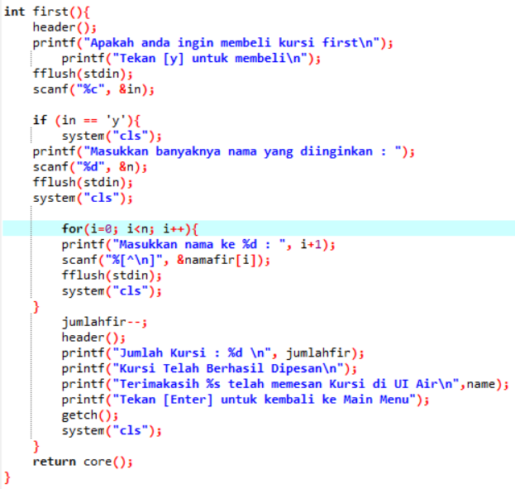

Slide 5
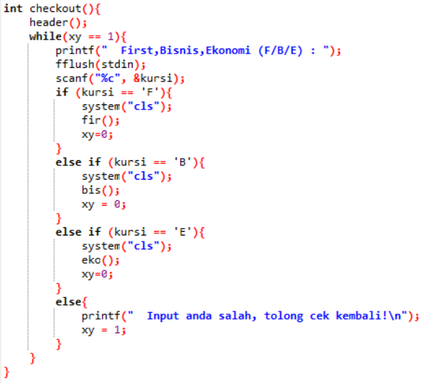
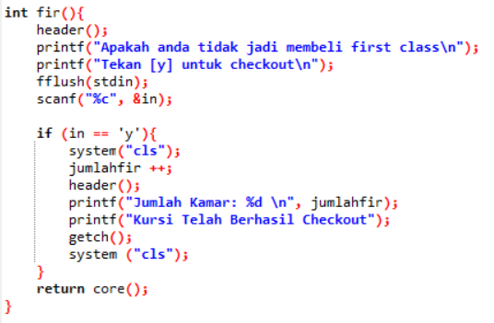
Pembatalan

Slide 6
Title and Content Layout with List
Add your first bullet point here
Add your second bullet point here
Add your third bullet point here

Slide 7
Title and Content Layout with Chart

Slide 8
Two Content Layout with Table
First bullet point here
Second bullet point here
Third bullet point here
Class | Group 1 | Group 2
Class 1 | 82 | 95
Class 2 | 76 | 88
Class 3 | 84 | 90

Slide 9
Two Content Layout with SmartArt
First bullet point here
Second bullet point here
Third bullet point here
Task 1
Task 2
Task 3

Slide 10
Add a Slide Title - 1

Slide 11
Add a Slide Title - 2

Slide 12
Add a Slide Title - 3

Slide 14
Add a Slide Title - 4

Slide 15
Add a Slide Title - 5

